Slide 1

Getting Started with MATLAB
04. Programming
Vahid Naeini
E-mail: naeini.v@gmail.com

Slide 2
Algorithms
An algorithm is the sequence of steps needed to solve a problem
3 Basic Steps:
Get the Input
Calculate the Results
Display the Results
You can input data via an external file, keyboard, etc.
Numerical calculations, image processing, learning automata, it could be anything, anything …
Display a number or string on monitor, save some information in a file or plot a curve on Cartesian axis
Getting Started with MATLAB / 04. Programming/ V.Naeini

Slide 3
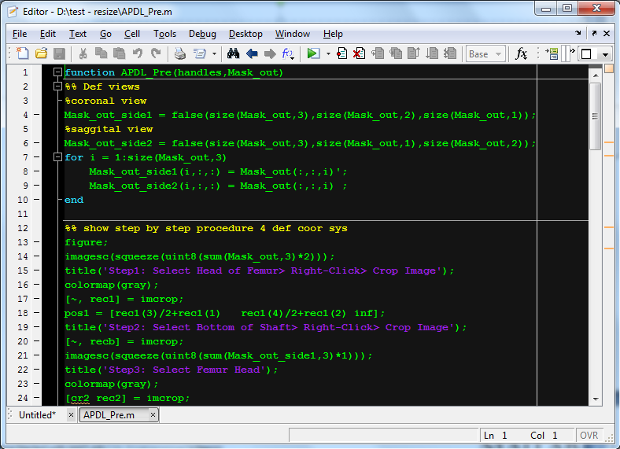
M-Files
Getting Started with MATLAB / 04. Programming/ V.Naeini

Slide 4
MATLAB Scripts
Script1 calculates area of a circle
Script1.m
radius = 5 area = pi * (radius^2)
>> type script1 %shows M-file radius = 5 area = pi * (radius^2)
>> script1 radius = 5 area = 78.5398
Getting Started with MATLAB / 04. Programming/ V.Naeini

Slide 5
MATLAB Scripts
Define a documentation for your script
circlescript.m
% This script calculates the area of a circle % First the radius is assigned radius = 5 % The area is calculated based on the radius area = pi * (radius^2)
>> help circlescript This script calculates the area of a circle
Getting Started with MATLAB / 04. Programming/ V.Naeini

Slide 6
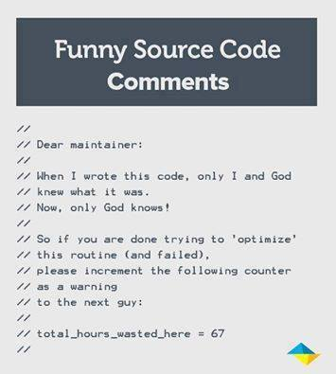
MATLAB Scripts
Never, ever, never forget to write %comments.
Soon you want to edit that piece of code and it will look like a vortex of entropy to you ☺
Getting Started with MATLAB / 04. Programming/ V.Naeini

Slide 7
MATLAB Scripts - Input
Input Function
If character or string is desired:
>> rad = input('Enter the radius: ') Enter the radius: 5 rad = 5
>>> letter = input('Enter a char: ','s') Enter a char: g letter = g
Getting Started with MATLAB / 04. Programming/ V.Naeini

Slide 8
Practice ☺
Write a small program which asks for a string and calculates the length of string
What would be the result if the user enters blank spaces after other characters? For example, the user here entered “xyz ” (four blank spaces):
mystr = input('Enter a string: ', 's') length(mystr)
Getting Started with MATLAB / 04. Programming/ V.Naeini

Slide 9
MATLAB Scripts - Input
>> num = input('Enter a number: ') Enter a number: n Error using input Undefined function or variable 'n'. Enter a number: 1 num = 1
>> n = 21 n = 21 >> num = input('Enter a number: ') Enter a number: n num = 21
Getting Started with MATLAB / 04. Programming/ V.Naeini

Slide 10
Practice ☺
Create a script that would prompt the user for a length, and then use ‘f’ for feet or ‘m’ for meters, and store both inputs in variables. For example, when executed it would look like this (assuming the user enters 12.3 and then m):
Enter the length: 12.3 Is that f(eet)or m(eters)?: m
Getting Started with MATLAB / 04. Programming/ V.Naeini

Slide 11
MATLAB Scripts - Output
disp function
disp does not allow formatting
>> disp(‘Mary had a little lamb') Mary had a little lamb >> disp(4^3) 64
Getting Started with MATLAB / 04. Programming/ V.Naeini

Slide 12
MATLAB Scripts - Output
fprintf function
>> fprintf('The value is %d, for sure!\n',4^3) The value is 64, for sure!
Next line
>> fprintf('Hey Dude! There’s a %s here!\n', ‘beverage') Hey Dude! There’s a beverage here!
“The Big Lebowski” movie. Directed by: Cohen Brothers
Getting Started with MATLAB / 04. Programming/ V.Naeini

Slide 13
MATLAB Scripts - Output
%d integer (it stands for decimal integer)
%f float (real number)
%c single character
%s string
Getting Started with MATLAB / 04. Programming/ V.Naeini

Slide 14
MATLAB Scripts - Output
Get two variables and print in a desired format
>> x = input('Hi\ninput x coordinate:'); y = input('input y coordinate:'); fprintf('( %3.2f , %3.2f )\n',x,y) Hi input x coordinate:6.45 input y coordinate:4.3 ( 6.45 , 4.30 )
Getting Started with MATLAB / 04. Programming/ V.Naeini

Slide 15
Practice ☺
Print a vector or a matrix.
>> vec = 2:5; >> fprintf('%d\n', vec) 2 3 4 5
>> mat = [5 9 8; 4 1 10]; >> fprintf('%d\n', mat) >> fprintf('%d %d %d\n', mat) >> fprintf('%d %d %d\n', mat') % Note the transpose
Getting Started with MATLAB / 04. Programming/ V.Naeini

Slide 16
User-Defined Functions
Every function that we write will be stored in a separate M-ﬁle
M-File name
functionname.m
function outputargument = functionname(input arguments) % Comment describing the function % Statements here; these must include putting a % value in the output argument end % of the function
documentation
Function name
Input/Output arguments
not necessary in many cases in current versions of MATLAB, but it is considered good style anyway
Body of Code
Getting Started with MATLAB / 04. Programming/ V.Naeini

Slide 17
User-Defined Functions
calcarea.m
function area = calcarea(rad) % calcarea calculates the area of a circle % Format of call: calcarea(radius) % Returns the area area = pi*rad^2; end
Example:
>> calcarea(4) ans = 50.2655 >> myarea = calcarea(6) myarea = 113.0973
Getting Started with MATLAB / 04. Programming/ V.Naeini

Slide 18
Question ?
Could we pass a vector of radii to the calcarea function?
>> calcarea([1 5 9]) % what will happen?
Error using * Inner matrix dimensions must agree.
area = pi * rad .^ 2
Getting Started with MATLAB / 04. Programming/ V.Naeini

Slide 19
User-Defined Functions
Calling a User-defined Function From a Script
circleCallFn.m
% This script calculates the area of a circle % It prompts the user for the radius radius = input('Please enter the radius: '); % It then calls our function to calculate the % area and then prints the result area = calcarea(radius); fprintf('For a circle with a radius of %.2f,',radius) fprintf(' the area is %.2f\n',area)
>> circleCallFn Please enter the radius: 5 For a circle with a radius of 5.00, the area is 78.54
Getting Started with MATLAB / 04. Programming/ V.Naeini

Slide 20
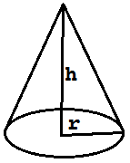
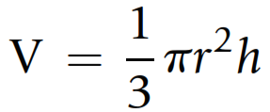
Practice ☺
Write a function to calculate volume of a cone
conevol.m
function outarg = conevol(radius, height) % conevol calculates the volume of a cone outarg = (pi/3) * radius .^ 2 .* height; end
Getting Started with MATLAB / 04. Programming/ V.Naeini

Slide 21
Selection Statement Flowchart
condition
true
true
false
false
action2
action1
action2
action1
In Programming, we make decisions in such way
Getting Started with MATLAB / 04. Programming/ V.Naeini

Slide 22


start
بهشت زهرا
گم شو تا لهت نکردم
بزنم لهت کنم؟
سرد خونه
یکراست بهشت زهرا میریم یا سرد خونه؟
?
کمربند
با چوب یا کمربند؟
چوب
تو سرم می‌زنی یا بدنم؟
بدن
?
ترجیح میدم الان بکشمت
سر
می‌میرم یا زنده می‌مونم؟
زنده می‌مونی
?
تیکه یخا
قالبی
می‌میری
یخاش قالبی باشه یا از این تیکه یخا؟
بیمارستان میلاد بریم یا اختر؟
میلاد
?
اختر
یخ
تو یخ می‌ذارید یا در جا اهدا می‌کنید؟
درجا اهدا می‌کنیم
میرم تو کما یا اهدای عضو می‌کنید؟
کما
?
?
اهدای عضو
?
قلب
اول قلبم یا کلیه‌ام؟
کلیه
Getting Started with MATLAB / 03. Cell Arrays and Structures/ V.Naeini

Slide 23
Selection Statement
if condition action end
if num < 0 num = 0 end
>> num = -5 if num < 0 num = 0 end num = 0
Getting Started with MATLAB / 04. Programming/ V.Naeini

Slide 24
Practice ☺
Create a function which creates a vector that iterates from a specified minimum to a maximum.
we would make sure that the value of mymin is less than the value of mymax.
outvec = createvec(mymin, mymax)
createvec.m
function outvec = createvec(mymin, mymax) if mymin > mymax temp = mymin; mymin = mymax; mymax = temp; end outvec = mymin:mymax; end
Getting Started with MATLAB / 04. Programming/ V.Naeini

Slide 25
Practice ☺
Use input to ask
And if input data was ‘y’ or ‘Y’ print
Explain why below expression is not correct:
Yes or No??(Y/N):
Okey!
yes.m
letter = input(‘Yes or No??(Y/N): ','s'); if letter == 'y' || letter == 'Y' disp(‘Okey!') end
letter == 'y' || 'Y'
Getting Started with MATLAB / 04. Programming/ V.Naeini

Slide 26
IF - ELSE
if condition action1 else action2 end
if rand < 0.5 disp('It was less than .5!') else disp('It was not less than .5!') end
Getting Started with MATLAB / 04. Programming/ V.Naeini

Slide 27
Nested IF-ELSE
if x < -1 y=1; end if x >= -1 && x <=2 y = x^2; end if x > 2 y=4; end
if x < -1 y=1; else if x<=2 y = x^2 else y=4 end end
Getting Started with MATLAB / 04. Programming/ V.Naeini

Slide 28
IF – ELSEIF -ELSE
if condition1 action1 elseif condition2 action2 elseif condition3 action3 elseif condition4 action4 else action5 end
Getting Started with MATLAB / 04. Programming/ V.Naeini

Slide 29
SWITCH
switch switch_expression case caseexp1 action1 case caseexp2 action2 case caseexp3 action3 % etc: there can be many of these otherwise action n end
Getting Started with MATLAB / 04. Programming/ V.Naeini

Slide 30
switchgrade.m
function grade = switchgrade(quiz) % this function convers scores if quiz < 0 || quiz > 10 grade = 'X'; else switch quiz case 10 grade = ‘A’; case 9 grade = ‘A’; case 8 grade = ‘B’; case 7 grade = ‘C’; case 6 grade = ‘D’; otherwise grade = ‘F’; end end
Getting Started with MATLAB / 04. Programming/ V.Naeini

Slide 31
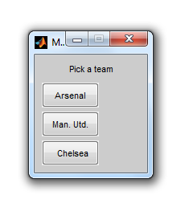
Menu Function
>> mypick = menu('Pick a team', ... ‘Arsenal',‘Man. Utd.',‘Chelsea');
mypick = 1
Getting Started with MATLAB / 04. Programming/ V.Naeini

Slide 32
Loop Statements
سوار تاکسی می‌شم
راننده داره مرتضی پاشایی گوش میده؟
false
Loop condition
true
از هدفون استفاده کن
loop
action
2 دقیقه صبر کن
اوکی! خطری نیست
Getting Started with MATLAB / 04. Programming/ V.Naeini

Slide 33
Loop Statements
for loopvar = range action end
>> for i=1:5 fprintf('%d\n',i) end 1 2 3 4 5
>> disp([1:5]’)
Getting Started with MATLAB / 04. Programming/ V.Naeini

Slide 34
Question
How could you print this column of integers (using the programming method):
0 50 100 150 200
>> for i=0:50:200 fprintf('%3d\n',i) end
Getting Started with MATLAB / 04. Programming/ V.Naeini

Slide 35
Loop Statements
for Loops that Do Not Use the Iterator Variable in the Action
for i=1:9 fprintf(‘all play and no work makes jack a dull boy\n’) end
all play and no work makes jack a dull boy all play and no work makes jack a dull boy all play and no work makes jack a dull boy all play and no work makes jack a dull boy all play and no work makes jack a dull boy all play and no work makes jack a dull boy all play and no work makes jack a dull boy all play and no work makes jack a dull boy all play and no work makes jack a dull boy
Getting Started with MATLAB / 04. Programming/ V.Naeini

Slide 36
Loop Statements
Use input function in for statement
This function returns sum of n numbers
sumnnums.m
function runsum = sumnnums(n) % sumnnums returns the sum of the n numbers % entered by the user runsum = 0; for i = 1:n inputnum = input('Enter a number: '); runsum = runsum + inputnum; end end
Getting Started with MATLAB / 04. Programming/ V.Naeini

Slide 37
Practice ☺
Write a function prodnnums that is similar to the sumnnums function, but will calculate the product of the numbers entered by the user
Getting Started with MATLAB / 04. Programming/ V.Naeini

Slide 38
Nested for Loops
for loopvarone = rangeone % actionone includes the inner loop for loopvartwo = rangetwo action2 end end
Outer loop
Inner loop
Getting Started with MATLAB / 04. Programming/ V.Naeini

Slide 39
Example
printstars.m
rows = 3; columns = 5; % loop over the rows for i = 1:rows for j = 1:columns fprintf('*') end fprintf('\n') end
>> printstars ***** ***** *****
Getting Started with MATLAB / 04. Programming/ V.Naeini

Slide 40
Question
Produce this pattern:
answer
* ** *** **** ***** ******
rows = 6; for i = 1:rows for j = 1:i fprintf('*') end fprintf('\n') end
Getting Started with MATLAB / 04. Programming/ V.Naeini

Slide 41
Combine loop and IF
sumofpositive.m
vec = randi([-10 10],1,10); sum = 0 ; for i = 1:length(vec) if vec(i)>0 sum = sum + 1; end end
Getting Started with MATLAB / 04. Programming/ V.Naeini

Slide 42
Break
Produce this pattern:
for i = 1:1000 if i>5 break; end disp(i) end
1 2 3 4 5
Getting Started with MATLAB / 04. Programming/ V.Naeini

Slide 43
Nested IF and Loop
OR:
Look for a pattern in DNA
Write a program that returns 1 if a specified pattern of chromosomes exists in the given sequence of them. Otherwise, it returns 0.
Getting Started with MATLAB / 04. Programming/ V.Naeini

Slide 44
Look for a pattern in DNA
Function
DNApat.m
function numpat = DNApat(S,P) numpat = 0; % check for being strings if isstr(S) && isstr(P) S = upper(S); P = upper(P); LS = length(S); LP = length(P); % check for lengths if LS >= LP for i = 1:LP if ~any(P(i) == ['T' 'A' 'G' 'C']) disp('Pattern is not Valid') break; end end | for i = 1:LS if ~any(S(i) == ['T' 'A' 'G' 'C']) disp('Sample is not Valid') break; end end for i=1:LS-LP+1 if S(i:i+LP-1) == P numpat = numpat + 1; disp(i); end end else disp('pattern is longer than sample'); end else disp('arguments are not string'); end end
Getting Started with MATLAB / 04. Programming/ V.Naeini

Slide 45
Look for a pattern in DNA
Input Arguments have to be strings
DNApat.m
function numpat = DNApat(S,P) numpat = 0; % check for being strings if isstr(S) && isstr(P) S = upper(S); P = upper(P); LS = length(S); LP = length(P); % check for lengths if LS >= LP for i = 1:LP if ~any(P(i) == ['T' 'A' 'G' 'C']) disp('Pattern is not Valid') break; end end | for i = 1:LS if ~any(S(i) == ['T' 'A' 'G' 'C']) disp('Sample is not Valid') break; end end for i=1:LS-LP+1 if S(i:i+LP-1) == P numpat = numpat + 1; disp(i); end end else disp('pattern is longer than sample'); end else disp('arguments are not string'); end end
Getting Started with MATLAB / 04. Programming/ V.Naeini

Slide 46
Look for a pattern in DNA
pattern length < sample length is invalid
DNApat.m
function numpat = DNApat(S,P) numpat = 0; % check for being strings if isstr(S) && isstr(P) S = upper(S); P = upper(P); LS = length(S); LP = length(P); % check for lengths if LS >= LP for i = 1:LP if ~any(P(i) == ['T' 'A' 'G' 'C']) disp('Pattern is not Valid') break; end end | for i = 1:LS if ~any(S(i) == ['T' 'A' 'G' 'C']) disp('Sample is not Valid') break; end end for i=1:LS-LP+1 if S(i:i+LP-1) == P numpat = numpat + 1; disp(i); end end else disp('pattern is longer than sample'); end else disp('arguments are not string'); end end
Getting Started with MATLAB / 04. Programming/ V.Naeini

Slide 47
Look for a pattern in DNA
pattern length < sample length is invalid
DNApat.m
function numpat = DNApat(S,P) numpat = 0; % check for being strings if isstr(S) && isstr(P) S = upper(S); P = upper(P); LS = length(S); LP = length(P); % check for lengths if LS >= LP for i = 1:LP if ~any(P(i) == ['T' 'A' 'G' 'C']) disp('Pattern is not Valid') break; end end | for i = 1:LS if ~any(S(i) == ['T' 'A' 'G' 'C']) disp('Sample is not Valid') break; end end for i=1:LS-LP+1 if S(i:i+LP-1) == P numpat = numpat + 1; disp(i); end end else disp('pattern is longer than sample'); end else disp('arguments are not string'); end end
Getting Started with MATLAB / 04. Programming/ V.Naeini

Slide 48
Look for a pattern in DNA
Only TAGC are valid
DNApat.m
function numpat = DNApat(S,P) numpat = 0; % check for being strings if isstr(S) && isstr(P) S = upper(S); P = upper(P); LS = length(S); LP = length(P); % check for lengths if LS >= LP for i = 1:LP if ~any(P(i) == ['T' 'A' 'G' 'C']) disp('Pattern is not Valid') break; end end | for i = 1:LS if ~any(S(i) == ['T' 'A' 'G' 'C']) disp('Sample is not Valid') break; end end for i=1:LS-LP+1 if S(i:i+LP-1) == P numpat = numpat + 1; disp(i); end end else disp('pattern is longer than sample'); end else disp('arguments are not string'); end end
Getting Started with MATLAB / 04. Programming/ V.Naeini

Slide 49
Look for a pattern in DNA
Only TAGC are valid
DNApat.m
function numpat = DNApat(S,P) numpat = 0; % check for being strings if isstr(S) && isstr(P) S = upper(S); P = upper(P); LS = length(S); LP = length(P); % check for lengths if LS >= LP for i = 1:LP if ~any(P(i) == ['T' 'A' 'G' 'C']) disp('Pattern is not Valid') break; end end | for i = 1:LS if ~any(S(i) == ['T' 'A' 'G' 'C']) disp('Sample is not Valid') break; end end for i=1:LS-LP+1 if S(i:i+LP-1) == P numpat = numpat + 1; disp(i); end end else disp('pattern is longer than sample'); end else disp('arguments are not string'); end end
Getting Started with MATLAB / 04. Programming/ V.Naeini

Slide 50
Look for a pattern in DNA
Only TAGC are valid
DNApat.m
function numpat = DNApat(S,P) numpat = 0; % check for being strings if isstr(S) && isstr(P) S = upper(S); P = upper(P); LS = length(S); LP = length(P); % check for lengths if LS >= LP for i = 1:LP if ~any(P(i) == ['T' 'A' 'G' 'C']) disp('Pattern is not Valid') break; end end | for i = 1:LS if ~any(S(i) == ['T' 'A' 'G' 'C']) disp('Sample is not Valid') break; end end for i=1:LS-LP+1 if S(i:i+LP-1) == P numpat = numpat + 1; disp(i); end end else disp('pattern is longer than sample'); end else disp('arguments are not string'); end end
Getting Started with MATLAB / 04. Programming/ V.Naeini

Slide 51
Look for a pattern in DNA
Look for desired pattern
DNApat.m
function numpat = DNApat(S,P) numpat = 0; % check for being strings if isstr(S) && isstr(P) S = upper(S); P = upper(P); LS = length(S); LP = length(P); % check for lengths if LS >= LP for i = 1:LP if ~any(P(i) == ['T' 'A' 'G' 'C']) disp('Pattern is not Valid') break; end end | for i = 1:LS if ~any(S(i) == ['T' 'A' 'G' 'C']) disp('Sample is not Valid') break; end end for i=1:LS-LP+1 if S(i:i+LP-1) == P numpat = numpat + 1; disp(i); end end else disp('pattern is longer than sample'); end else disp('arguments are not string'); end end
Getting Started with MATLAB / 04. Programming/ V.Naeini

Slide 52
check for a pattern in DNA
>> S='TAGTACACACGTGTGCAAACGTGACTGCATGCATGCACGATCGAACGACGACTAGCTGCATCGATCGACGAT'; >> P='CG'; >> numpat = DNApat(S,P) 10 20 38 42 46 49 62 66 69 numpat = 9
Getting Started with MATLAB / 04. Programming/ V.Naeini

Slide 53
check for a pattern in DNA
>> allpats = 'TCGA'; >> randS = allpats(randi([1 4],1,30)) randS = TGGGCGCGTGTCGATAACCCCGGAAGCAGC >> numpat = DNApat(randS,'GT') 8 10 numpat = 2
Getting Started with MATLAB / 04. Programming/ V.Naeini

Slide 54
WHILE
while condition action end
myFactorial.m
function facgt = myFactorial(num) % returns the first factorial i=0; fac =1; while fac<=high i = i+1; fac = fac * 1; end facgt = fac; end
Getting Started with MATLAB / 04. Programming/ V.Naeini

Slide 55
WHILE
Counting while loop
countposnum.m
counter=0; inputnum=input('Enter a positive number: '); while inputnum >= 0 fprintf('You entered a %d.\n\n',inputnum) counter = counter + 1; inputnum = input('Enter a positive number: '); End fprintf('Thanks, you entered %d positive numbers.\n',counter)
Getting Started with MATLAB / 04. Programming/ V.Naeini

Slide 56
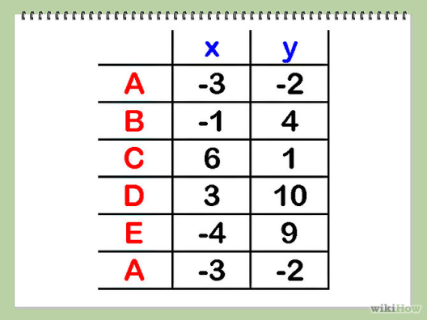
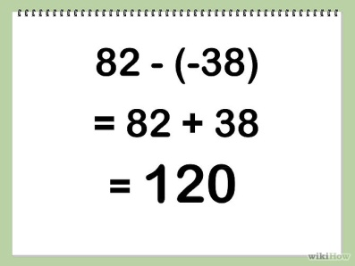
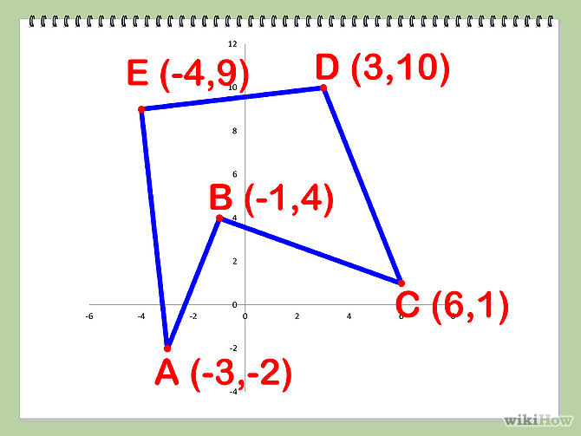
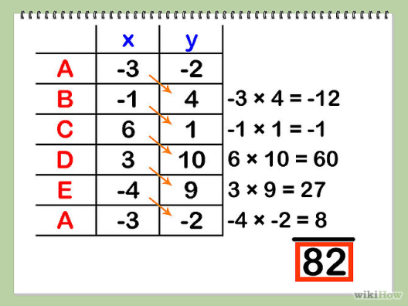
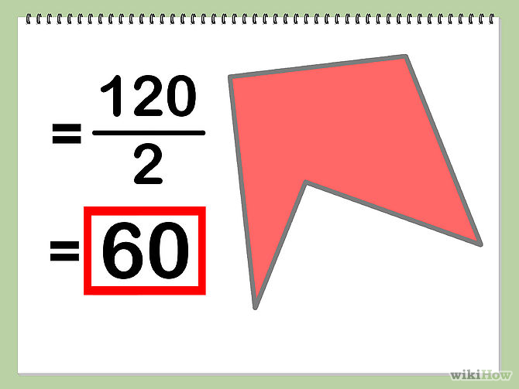
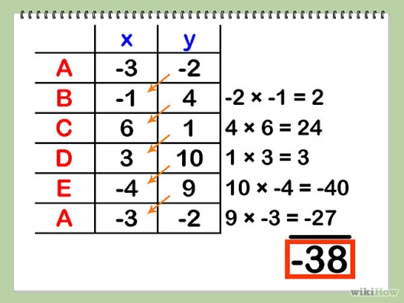
Practice : Finding the Area of Irregular Polygons
Source:
http://www.wikihow.com/Calculate-the-Area-of-a-Polygon
Getting Started with MATLAB / 04. Programming/ V.Naeini

Slide 57
Finding the Area of Irregular Polygons
polygonarea.m
points = []; counter = 0; while true % <-------- counter = counter + 1; % represents the number of last point fprintf(‘** Point Number %d **\n',counter); xcoor = input('input x coordinate : '); ycoor = input('input y coordinate : '); points(counter,:) = [xcoor,ycoor]; if counter<3 % at least we need 3 points to create a polygon fprintf('Enter next point\n'); else yesno = input('Do you want to enter another point? (Y/N) ','s'); if yesno == 'n' || yesno == 'N' break % if you type ‘N’ breakes the loop end end end points(counter+1,:) = points(1,:); A1 = sum(points(1:counter-1,1).*points(2:counter,2)); A2 = sum(points(1:counter-1,2).*points(2:counter,1)); area = (A1-A2)/2; fprintf('total number of points: %d, Area: %.3f \n', counter,area);
Getting Started with MATLAB / 04. Programming/ V.Naeini

Slide 58
Timing
tic toc …
Calculates elapsed time of your code
Getting Started with MATLAB / 04. Programming/ V.Naeini

Slide 59
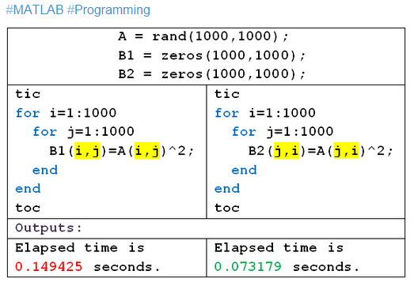
Timing
Same output while one runs at double speed,
Explain why ?
Answer: MATLAB is column-major. Therefore, it’s easier to access memory units this way
Getting Started with MATLAB / 04. Programming/ V.Naeini

Slide 60

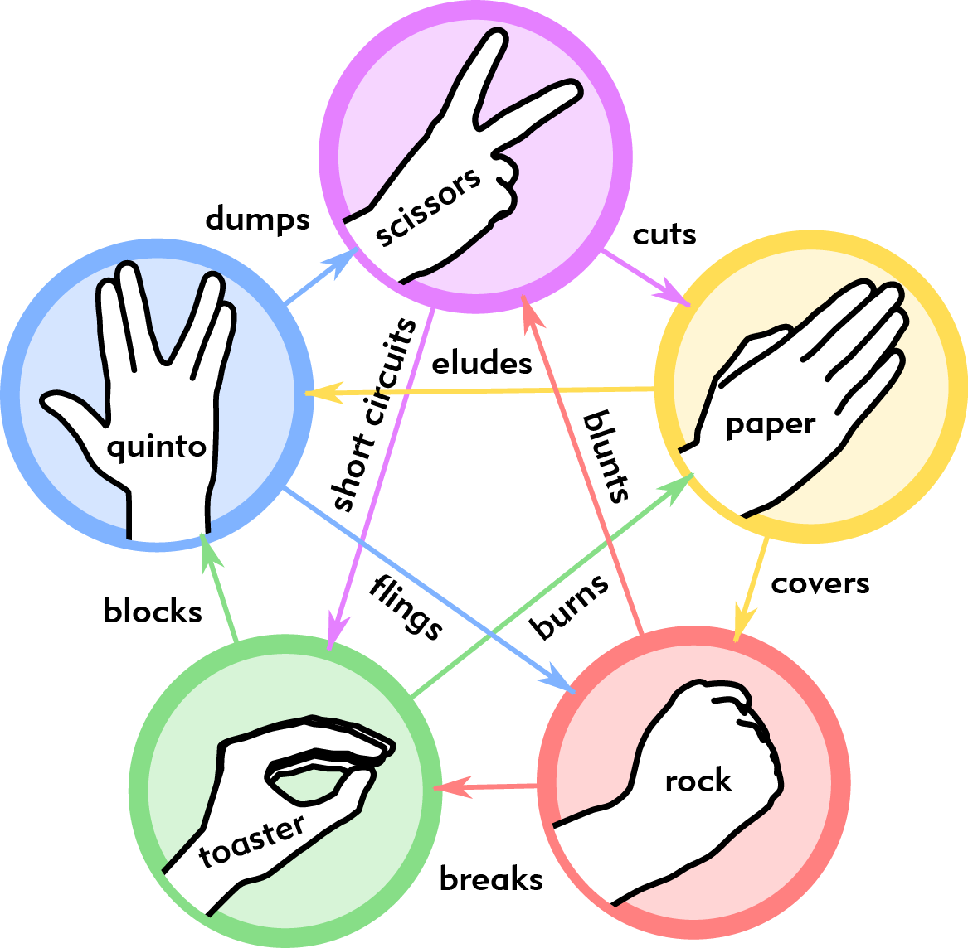
Mini Project :
Rock, Paper, Scissors, Lizard, Spock
Getting Started with MATLAB / 04. Programming/ V.Naeini

